Slide 1
Batch Normalization: Accelerationg Deep Network Tranining by Reducing Internal Covariate Shift
박중천

Slide 2
목차
Learning Problem in DNN: Internal Covariate Shift
Towards Reducing Internal Covariate Shift
Batch Normalization
Advantage of Batch Norm
Experiment

Slide 3
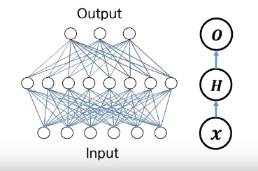
Learning problem in DNN
Training ANN is difficult

Slide 4
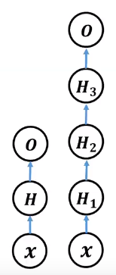
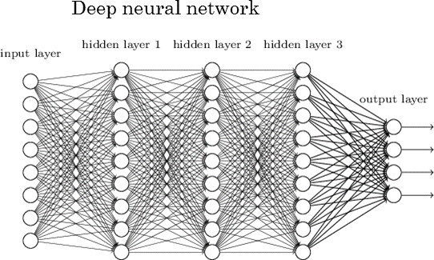
Learning problem in DNN
Training DNN is more difficult

Slide 5
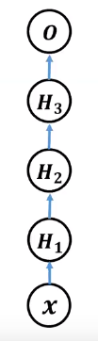
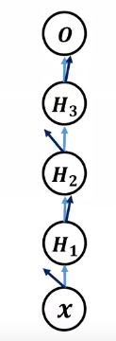
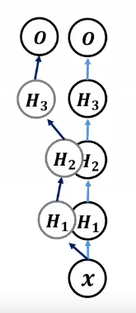
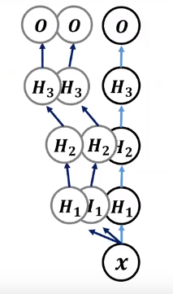
Learning problem in DNN
Small change in all weights could make vary different value in upper layer

Slide 6
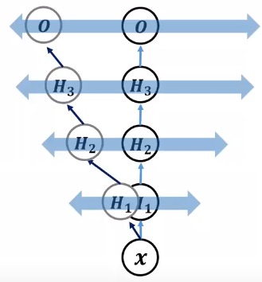
Learning problem in DNN
This variance is called ‘Internal Covariate Shift’

Slide 7
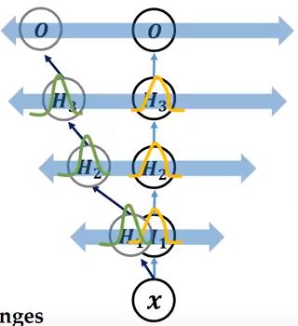
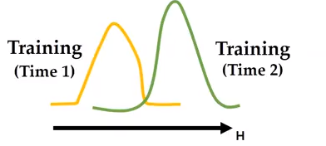
Learning problem in DNN
The distribution of each layer’s input changes during training

Slide 8
Towards Reducing Internal Covariate Shift
To address this Internal Covariate Shift Problem, previous studies used
careful initialization
small learning rate
whitening

Slide 9
Towards Reducing Internal Covariate Shift
whitening
Activation function
X1…N
w1
w2
X’1…N

Slide 10
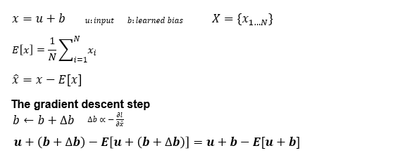
Towards Reducing Internal Covariate Shift
Loss function =1/2*(xtarget-x)^2

Slide 11
Towards Reducing Internal Covariate Shift
whitening
u
+b
x
Loss function =1/2*(xtarget-x)^2

Slide 12
Towards Reducing Internal Covariate Shift
epoch1
Initial b=3
u | x | Xhat | Xtarget | Delta b | b update
1 | 4 | -2 | 2 | -4 | 7
2 | 5 | -1 | 3 | -4 | 7
3 | 6 | 0 | 4 | -4 | 7
4 | 7 | 1 | 5 | -4 | 7
5 | 8 | 2 | 6 | -4 | 7

Slide 13
Towards Reducing Internal Covariate Shift
epoch2
Initial b=7
u | x | Xhat | Xtarget | Delta b | b update
1 | 8 | -2 | 2 | -4 | 11
2 | 9 | -1 | 3 | -4 | 11
3 | 10 | 0 | 4 | -4 | 11
4 | 11 | 1 | 5 | -4 | 11
5 | 12 | 2 | 6 | -4 | 11
b will grow indefinitely while loss remains fixed
normalization parameters are computed outside the gradient descent step

Slide 14
Towards Reducing Internal Covariate Shift
Lyu&simoncelli
use statistics computed over a single training example etc
But this changes the representation ablility of a net work by discarding the absolute scale of activations
Batch normalization

Slide 15

Batch Normalization
To make training speed fast and easy learning(in gradient descent ), batch Norm is proposed
If the change of dist . Is not large, training weight is easy

Slide 16

Batch Normalization
H2
Activation:
Changing Part:
wx
X

Slide 17
Batch Normalization
Batch Norm want to restrict change of wx
A
H2
Activation:
A
BN
Changing Part:
wx
wx
X
X

Slide 18
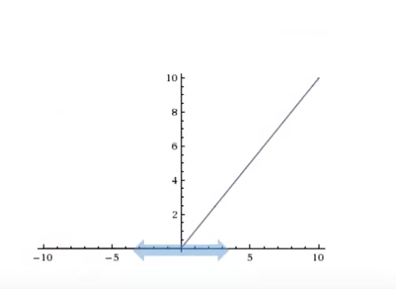
Batch Normalization

Slide 19
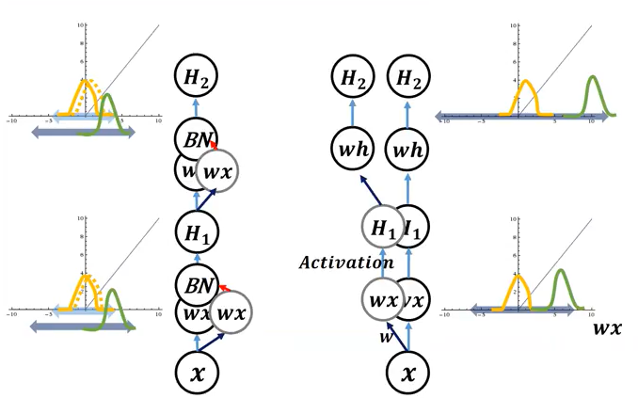
Batch Normalization

Slide 20
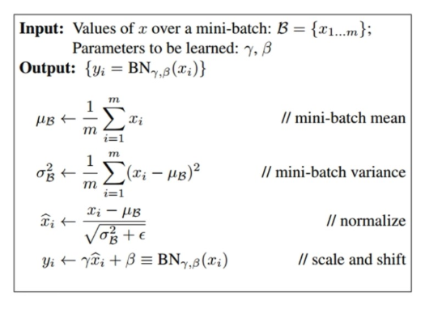
Batch Normalization

Slide 21
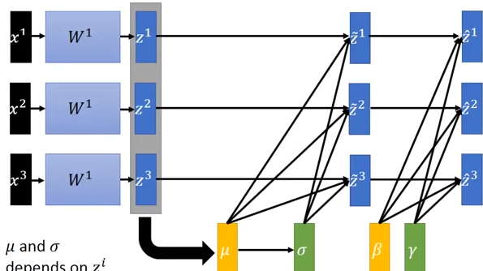

Slide 22
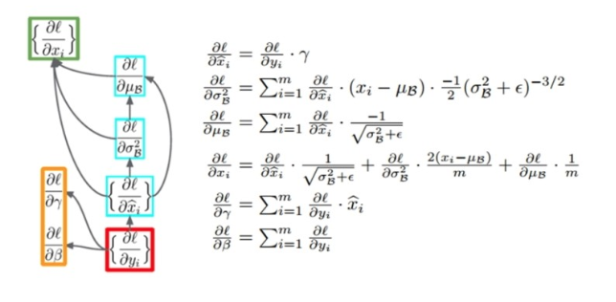
Batch Normalization
https://kevinzakka.github.io/2016/09/14/batch_normalization/
Back-propagation, chain rule

Slide 23
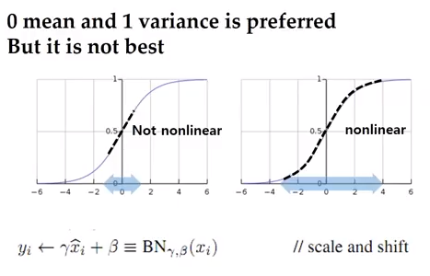
Batch Normalization

Slide 24
Batch Noramlization
Data
Batch 1
Batch 2
Batch 3

Slide 25
Batch Noramlization
Data
wx1
A
Batch 1
batchu,σ^2
wx2
wx3
Batch 2
BN
Batch 3
wx

Slide 26
Batch Noramlization
Data
wx1
A
Batch 1
batchu,σ^2
wx2
wx3
Batch 2
BN
Batch 3
wx

Slide 27
Batch Noramlization
Data
wx1
A
Batch 1
batchu,σ^2
wx2
wx3
Batch 2
BN
Batch 3
wx
Batch1 r,β

Slide 28

Batch Noramlization
Data
batch1u,σ^2
Batch1 r,β
Batch 1
A
batch2u,σ^2
Batch2 r,β
Batch 2
BN
Batch3
u,σ^2
Batch3 r,β
Batch 3
wx
lastbatch r,β

Slide 29
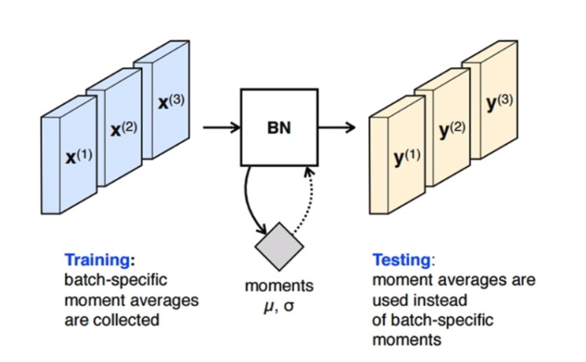
Batch Normalization

Slide 30
Advantage of Batch Norm
Batch Normalization enables higher learning rates(fast)
Batch Normalization regularizes the model
Initialzation
Gradient vanish,getting stuck local minima

Slide 31
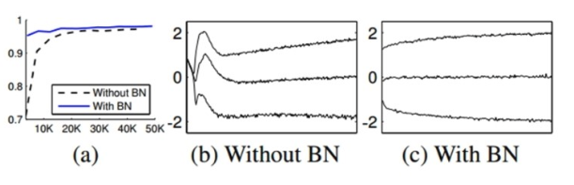
Advantage of Batch Norm

Slide 32
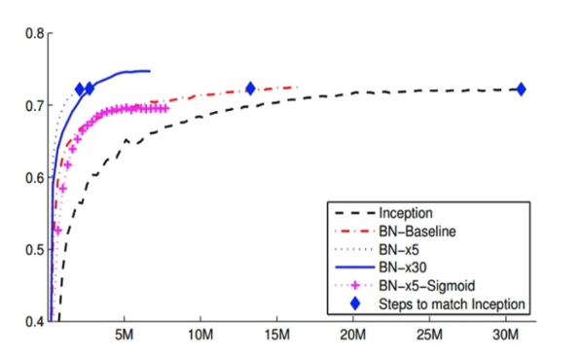
Advantage of Batch Norm

Slide 33
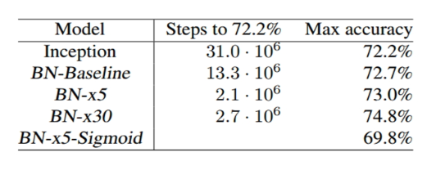
Advantage of Batch Norm

Slide 34
Experiment
MNIST
CNN의 대표적인 데이터 셋인 흑백 필기 인식 데이터
28*28 size 60000개의 training set 과 10000개의 test set
0에서 9 사이의 필기 숫자를 구별하는 과제
Batch Normalization 의 lr과 activation function에 따른 학습 평가

Slide 35
Experiment
모델 설명

Slide 36

Experiment

Slide 37
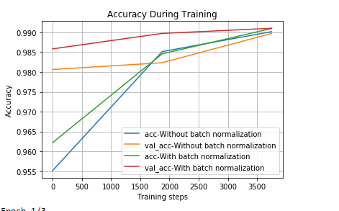
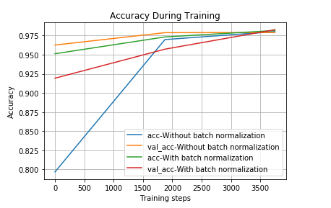
Experiment
Learning rate 0.001 relu, sigmoid

Slide 38
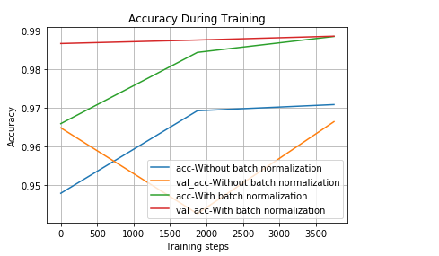
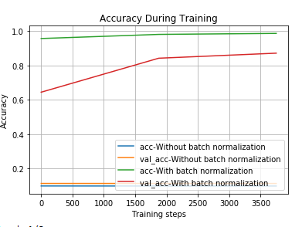
Experiment
Learning rate 0.01 relu, sigmoid

Slide 39
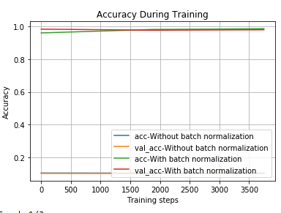
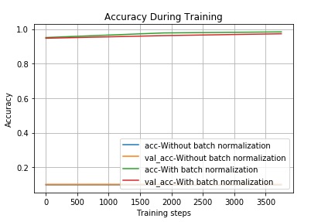
Experiment
Learning rate 0.05 relu, sigmoid

Slide 40
끝
Q&A

